Slide 1
Unit -3
Packages
Data Input and Output in R

Slide 2
Packages
R packages are a collection of R functions, complied code and sample data. They are stored under a directory called "library" in the R environment. By default, R installs a set of packages during installation. More packages are added later, when they are needed for some specific purpose. When we start the R console, only the default packages are available by default. Other packages which are already installed have to be loaded explicitly to be used by the R program that is going to use them.

Slide 3
Get library locations containing R packages:-
libPaths()
Get the list of all the packages installed
library()

Slide 4
Install and load a New Package
Install directly from CRAN
Install.packages(“Package Name”)
Eg:-
install.packages("XML")
Install package manually
Go to install option in the packages and then write the name of the package you want to install.
Loading the package
library(package name)

Slide 5
Working with the packages
To view complete list of packages available in the R library:
Installed.packages()
Perform the following steps to install packages in R
Open the RGui and select the Packages tab
Select the Install package(s) option
Select the country of your choice and click ok
Packages dialog box appears
Select the packages that you want to include in your R library

Slide 6
You can load the package in R script by using library() function.
Syntax:
library(“package_name”)

Slide 7
Input and Output in R
In R, we can read data from files stored outside the R environment. We can also write data into files which will be stored and accessed by the operating system. R can read and write into various file formats like csv, excel, xml etc.
In this chapter we will learn to read data from a csv file and then write data into a csv file. The file should be present in current working directory so that R can read it.
To get the working directory, execute
getwd()
Example:
> getwd()
[1] "C:/Users/sameera/Documents"

Slide 8
Input as CSV File
The csv file is a text file in which the values in the columns are separated by a comma.
Create this file in the notepad and save it in the working directory with Save as All files option as .csv file
id,name,salary,start_date,dept
1,Rick,623.3,2012-01-01,IT
2,Dan,515.2,2013-09-23,Operations
3,Michelle,611,2014-11-15,IT
4,Ryan,729,2014-05-11,HR
5,Gary,843.25,2015-03-27,Finance
6,Nina,578,2013-05-21,IT
7,Simon,632.8,2013-07-30,Operations
8,Guru,722.5,2014-06-17,Finance

Slide 9
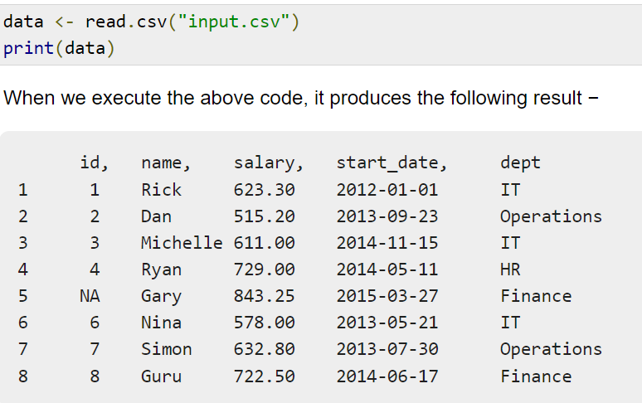
Reading a CSV File

Slide 10
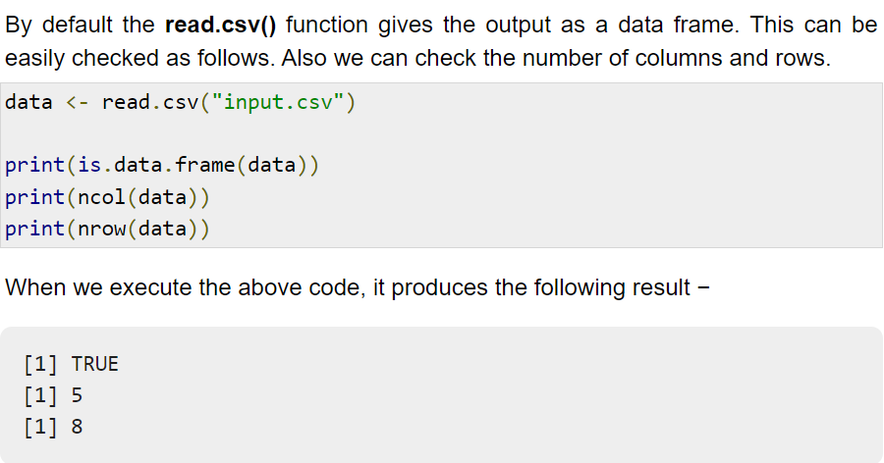
Analyzing CSV File

Slide 11
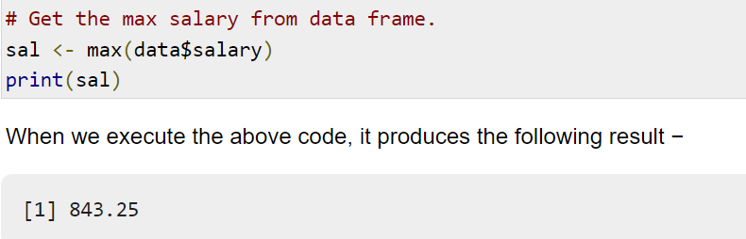
Use of some predefined functions

Slide 12
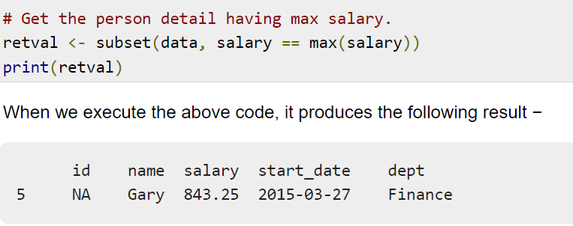

Slide 13
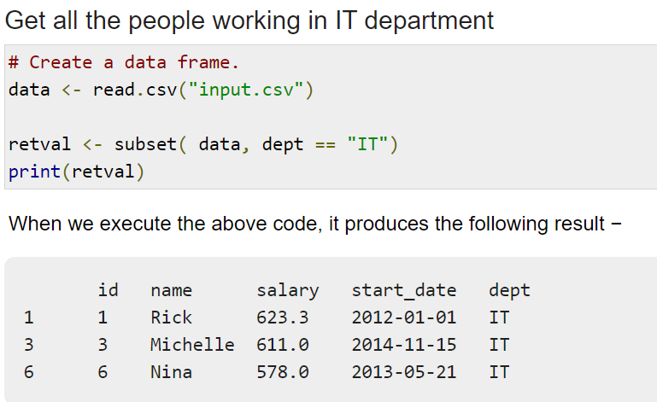

Slide 14
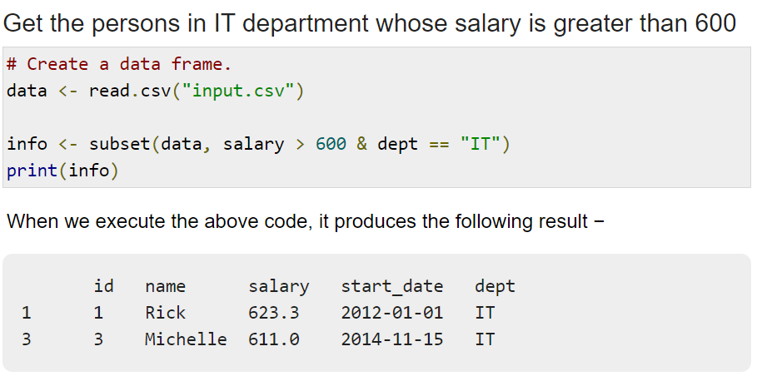

Slide 15
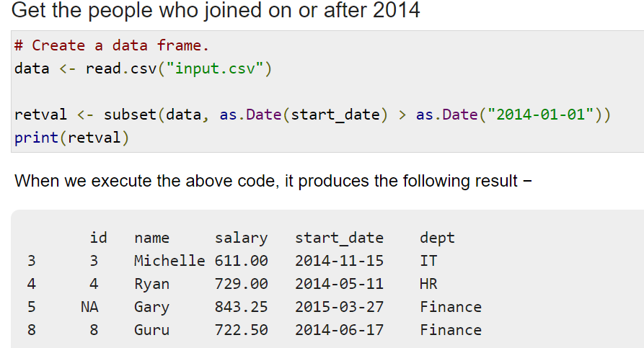

Slide 16
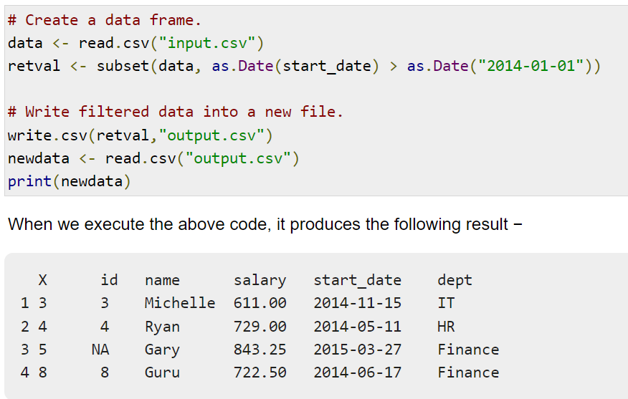
Writing into a CSV File

Slide 17
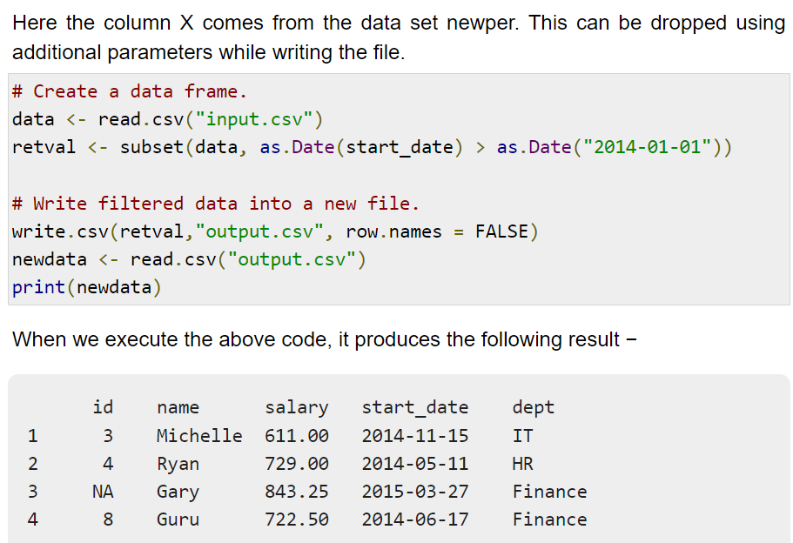

Slide 18
Using Build-in Datasets in R
To see the list of build-in datasets
data()
Lists the build-in datasets in all the currently installed packages:
data(package = .packages(all.available = TRUE))
To access a particular dataset
data(name_dataset)
Example:
data(iris)
iris

Slide 19
Read Excel file in R
install.packages("readxl")
library(readxl)
d1=read_excel(file.choose())
# A tibble: 8 x 5
id name salary start_date dept
<dbl> <chr> <dbl> <dttm> <chr>
1 1 Rick 623. 2012-01-01 00:00:00 IT
2 2 Dan 515. 2013-09-23 00:00:00 Operations
3 3 Michelle 611 2014-11-15 00:00:00 IT
4 4 Ryan 729 2014-05-11 00:00:00 HR
5 5 Gary 843. 2015-03-27 00:00:00 Finance
6 6 Nina 578 2013-05-21 00:00:00 IT
7 7 Simon 633. 2013-07-30 00:00:00 Operations
8 8 Guru 722. 2014-06-17 00:00:00 Finance

Slide 20
View(d1)
Output:in the tabular format

Slide 21
SQL Commands
df=read.csv("input.csv")
df
Output:
id name salary start_date dept
1 1 Rick 623.30 2012-01-01 IT
2 2 Dan 515.20 2013-09-23 Operations
3 3 Michelle 611.00 2014-11-15 IT
4 4 Ryan 729.00 2014-05-11 HR
5 5 Gary 843.25 2015-03-27 Finance
6 6 Nina 578.00 2013-05-21 IT
7 7 Simon 632.80 2013-07-30 Operations
8 8 Guru 722.50 2014-06-17 Finance

Slide 22
>sqldf("select * from df")
id name salary start_date dept
1 1 Rick 623.30 2012-01-01 IT
2 2 Dan 515.20 2013-09-23 Operations
3 3 Michelle 611.00 2014-11-15 IT
4 4 Ryan 729.00 2014-05-11 HR
5 5 Gary 843.25 2015-03-27 Finance
6 6 Nina 578.00 2013-05-21 IT
7 7 Simon 632.80 2013-07-30 Operations
8 8 Guru 722.50 2014-06-17 Finance

Slide 23
> sqldf("select [name],[salary] from df")
name salary
1 Rick 623.30
2 Dan 515.20
3 Michelle 611.00
4 Ryan 729.00
5 Gary 843.25
6 Nina 578.00
7 Simon 632.80
8 Guru 722.50

Slide 24
> sqldf("select * from df order by salary")
id name salary start_date dept
1 2 Dan 515.20 2013-09-23 Operations
2 6 Nina 578.00 2013-05-21 IT
3 3 Michelle 611.00 2014-11-15 IT
4 1 Rick 623.30 2012-01-01 IT
5 7 Simon 632.80 2013-07-30 Operations
6 8 Guru 722.50 2014-06-17 Finance
7 4 Ryan 729.00 2014-05-11 HR
8 5 Gary 843.25 2015-03-27 Finance

Slide 25
> sqldf('select * from df limit 5')
id name salary start_date dept
1 1 Rick 623.30 2012-01-01 IT
2 2 Dan 515.20 2013-09-23 Operations
3 3 Michelle 611.00 2014-11-15 IT
4 4 Ryan 729.00 2014-05-11 HR
5 5 Gary 843.25 2015-03-27 Finance

Slide 26
> sqldf("select max(salary) from df")
max(salary)
1 843.25
> sqldf("select min(salary) from df")
min(salary)
515.2
> sqldf("select avg(salary)from df")
avg(salary)
1 656.8813

Slide 27
> sqldf('select name from df where salary<600')
name 1 Dan 2 Nina

Slide 28
> sqldf('select * from df where name IN("Rick","Nina")')
id name salary start_date dept
1 1 Rick 623.3 2012-01-01 IT
2 6 Nina 578.0 2013-05-21 IT

Slide 29
> sqldf('select * from df where name like"%a"')
id name salary start_date dept
6 Nina 578 2013-05-21 IT
> sqldf('select * from df where name like"R%"')
id name salary start_date dept
1 1 Rick 623.3 2012-01-01 IT
2 4 Ryan 729.0 2014-05-11 HR

Slide 30
> sqldf(c("delete from df where name='Rick'","select * from df"))
id name salary start_date dept
1 2 Dan 515.20 2013-09-23 Operations
2 3 Michelle 611.00 2014-11-15 IT
3 4 Ryan 729.00 2014-05-11 HR
4 5 Gary 843.25 2015-03-27 Finance
5 6 Nina 578.00 2013-05-21 IT
6 7 Simon 632.80 2013-07-30 Operations
7 8 Guru 722.50 2014-06-17 Finance

Slide 31
df <- sqldf(c("update df set name='Rish' where name='Dan'", "select * from df"))
> sqldf("select * from df")
id name salary start_date dept
1 1 Rick 623.30 2012-01-01 IT
2 2 Rish 515.20 2013-09-23 Operations
3 3 Michelle 611.00 2014-11-15 IT
4 4 Ryan 729.00 2014-05-11 HR
5 5 Gary 843.25 2015-03-27 Finance
6 6 Nina 578.00 2013-05-21 IT
7 7 Simon 632.80 2013-07-30 Operations
8 8 Guru 722.50 2014-06-17 Finance

